Slide 1

Connecting Azure Sphere with IoT Central
Wriju Ghosh
Cloud Solution Architect, Microsoft

Slide 2
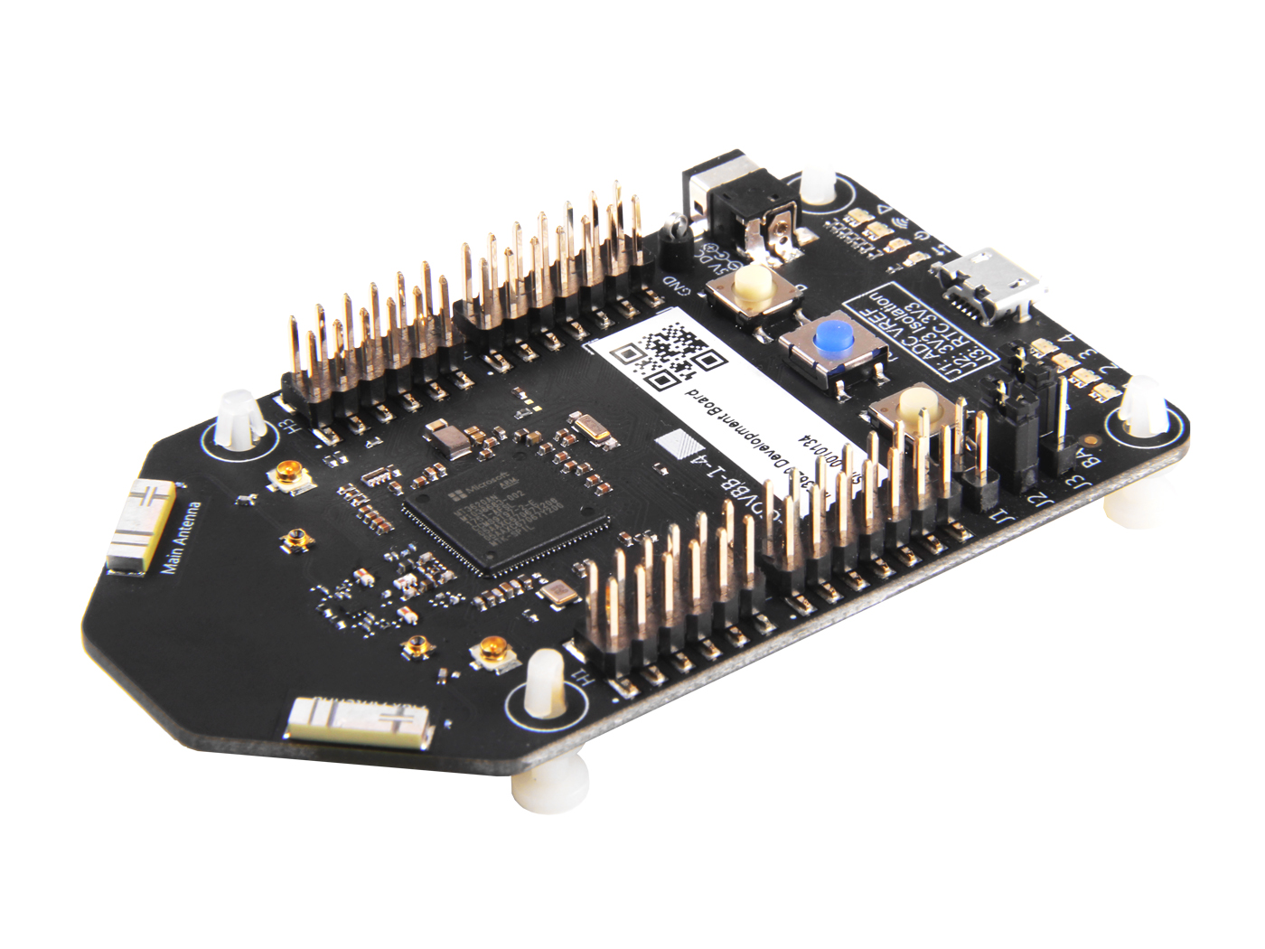
Azure Sphere MT3620
Now available
Azure Sphere development kits from Seeed studios
Availability
Azure Sphere OS
Azure Sphere Security Service
Visual Studio tools for Azure Sphere
Try today:: http://www.azure-sphere.com

